Slide 1
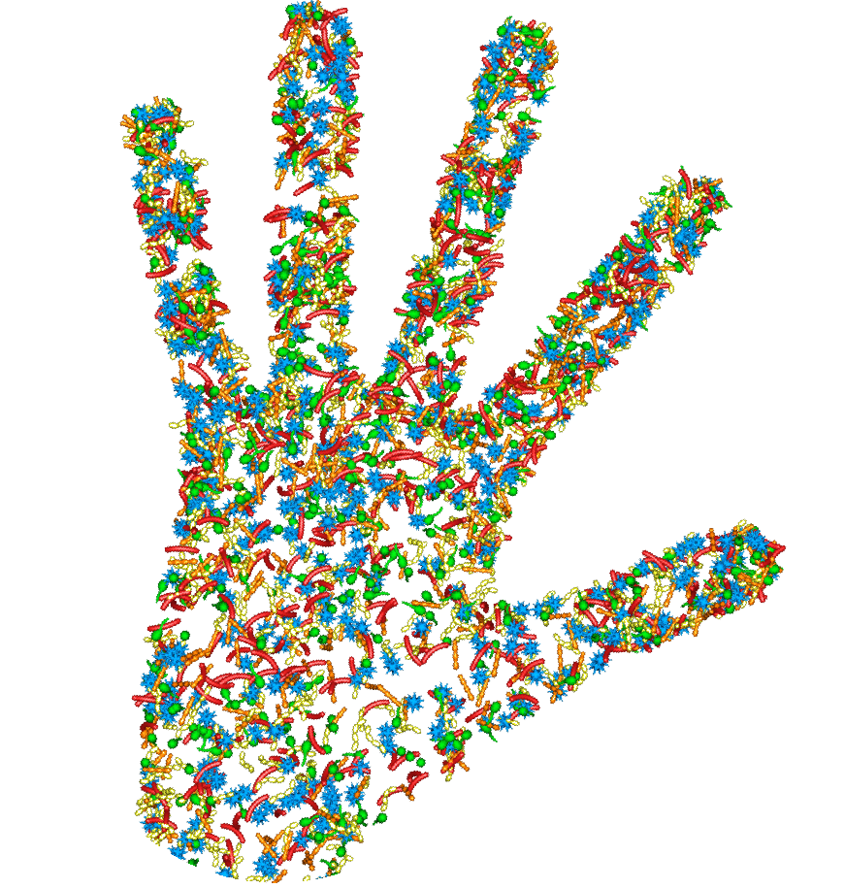
Mind Your Microbes and prevent Antibiotic Resistance
GET INVOLVED
Organise an event and register it at: http://worldmicrobiomeday.com
@WMicrobiomeDay
worldmicrobiomeday
www.facebook.com/WorldMicrobiomeDay/
Hashtags: #WorldMicrobiomeDay; #MindYourMicrobes ; #AntibioticResistance; #MicrobiomeAmbassador

